Slide 1

COMP1516
Lesson 5: Files, scope, refs, debugging

Slide 2
Topics
Files
Local vs. global scope
Object references
Debugging

Slide 3
Files
File handling refers to the process of opening a file with various permissions (e.g. for reading and writing, for reading only, etc…), reading and/or writing to the file, and closing the file.
A typical pattern for working with files is:
1. open the file with a certain permission and assign a file handle file = open(“books.txt”, “r”)
2. read/write to the file handle string = file.read()
3. close the file handle file.close()

Slide 4
Files
Always close a file you open.
Failing to close a file that you opened can result in a variety of issues:
- a permanently-locked state (inaccessible for operations now)
- a corrupted file
- any writing may have gone uncommitted (so, no write actually happened)

Slide 5
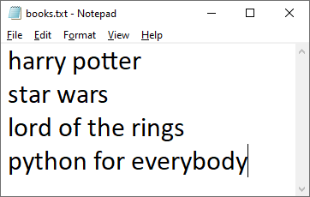
Files: Reading and Writing
Let’s create a file (or overwrite it if the file already exists), write data on four separate lines, then close the file.
f = open(“books.txt”, “w”)
f.write(“harry potter\nstar wars\nlord of the rings\npython for everybody”)
f.close()

Slide 6
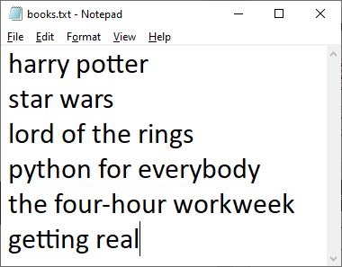
Files: Appending
Let’s open the file and append (i.e. add to the end) data on two more separate lines, then close the file.
f = open(“books.txt”, “a”)
f.write(“\nthe four-hour workweek\ngetting real”)
f.close()

Slide 7
Files: Reading
Let’s read the file and dump it into a list (one line = one element):
f = open("books.txt", "r")
file_as_list = f.readlines()
f.close()
print("entire file is %s" % file_as_list)
Output:
entire file is ['harry potter\n', 'star wars\n', 'lord of the rings\n', 'python for everybody\n', 'the four-hour workweek\n', 'getting real']

Slide 8
Files: Reading
Let’s read the file and dump it into a string (one file = one string):
f = open("books.txt", "r")
file_as_string = f.read()
f.close()
print("entire file is %s" % file_as_string)
Output:
entire file is harry potter
star wars
lord of the rings
python for everybody
the four-hour workweek
getting real

Slide 9
Files: Modes
f = open("books.txt", "r")
The instruction above opens the file for reading only.
The “r” is called the mode.
Reading is the default mode, so in this case we could have omitted it and written f = open(“books.txt”).
Other modes:
w writing only; totally overwrites an existing file; tries to create file if it doesn’t exist
x creates a file and opens it for writing; if the file exists already an error is given
a appending; writes to the end of an existing file; creates file if it doesn’t exist already
r+ reading and writing; gives an error if the file does not exist
w+ writing and reading; creates the file if it does not exist
a+ appending and reading
x+ creation and reading

Slide 10
Variable Scope: Local Variables
Scope refers to where a variable is accessible.
Examples include “in this loop only”, “in this function only”, “in this file only”, etc….
Function Scope (aka Local Scope) means a variable is defined inside a function.
These “local variables” are accessible only inside that function.
def get_name(first, last):
# name is a local variable, accessible only inside the function
name = first.title() + ' ' + last.title()
return name
print(get_name('tiger', 'woods')) # Tiger Woods
print(name) # NameError: name 'name" is not defined (outside of the function)

Slide 11
Variable Scope: Writing to Globals
The keyword global must be used to change the value of a global variable from inside of a function.
first_name = 'tiger’ # global variable (i.e. declared/accessible in the script itself, NOT in a function)
def change():
first_name = 'jason’ # syntax error: cannot change global variable from inside a function!
change()
print(first_name) # tiger NOT CHANGED

Slide 12
Variable Scope: Writing to Globals
The keyword global must be used to change the value of a global variable from inside of a function.
first_name = 'tiger’
def change():
global first_name # telling python “I am referring to the global variable, on purpose”
first_name = 'jason’ # ok; changed
change()
print(first_name) # jason CHANGED

Slide 13
References
Python uses “pass-by-assignment” which means:
When you pass a parameter, its value can change inside the function but it won’t change the passer’s value outside of the function.
def birthday(age):
age = age + 1 #changes to 8 INSIDE THE FUNCTION ONLY, so…
timmy_age = 7
birthday(timmy_age) # timmy_age won’t be changed
print timmy_age # …timmy_age is still 7

Slide 14
References
When a function modifies a parameter, whether or not that modification is seen outside the scope of the function depends on the mutability of the argument object.
If the object is immutable, such as a string or integer or tuple, then the modification is limited to inside the function. Any modification to an immutable object results in the creation of a new object in the function's local scope, thus leaving the original argument object unchanged.
If the object is mutable, though, then in-place modification of the object can be seen outside the scope of the function. Any operation like adding elements to a list or sorting a list that is performed within a function will also affect any other variables in the program that reference the same object.
def modify(the_list):
the_list[1] = 99
my_list = [10, 20, 30]
modify(my_list)
print(my_list) # my_list now is [10, 99, 30] # CHANGED

Slide 15
PyCharm Debugger
Three important components that are useful in this (and all) debuggers:
1. watch window: see what the program is storing in variables
2. stack trace: see where the program is coming from and going to
3. step: one at a time, execute (and/or skip) individual instructions
We can put a “breakpoint” in our code and then Debug it. The program will run until it reaches the breakpoint and then pause. Put a breakpoint at any executable line of code by clicking in the margin to the right of the line number (see next slide).

Slide 16
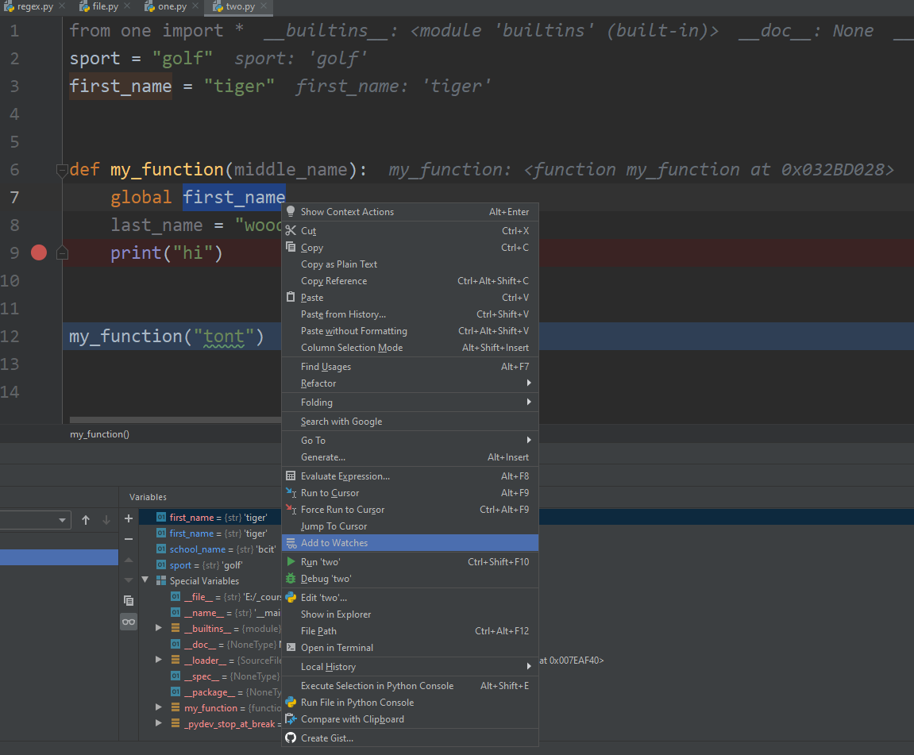
Watch
Watch Window:
see what my script named ‘two’ is storing in variables:
Instead of Run ‘two’, highlight variables and select Add to Watches
Then select Debug ‘two’
Now we see the values of the variables in the Debugger console at the bottom.

Slide 17
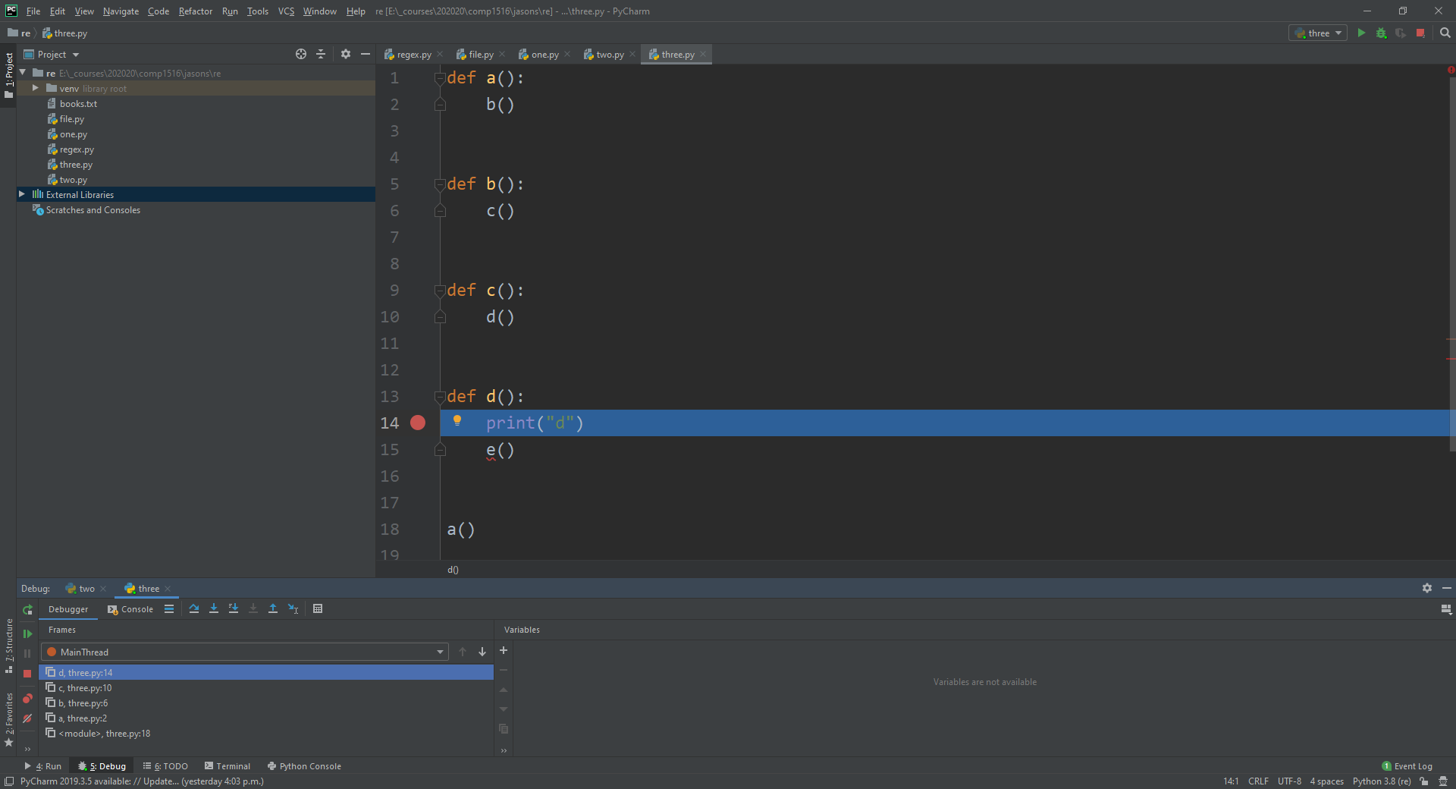
Stack Trace
Stack Trace:
I put a breakpoint on line 14, inside the d() function, and the stack trace at the bottom- right of the debugger console shows that d() is on the top of the stack (imagine a stack of plates), and we can see that d() was called from c() which was called from b() which was called from a()…and we can see that none of these four functions are yet closed (finished). We can see how we got to d().

Slide 18
Step
Step:
Once your program has stopped at a breakpoint, we can choose to step into that line (for instance, if the line is a function call), or step over it one “line” at a time, by using the little arrows at the top of the debugging console.

